Slide 1


K-Nearest Neighbours algorithm
Teacher
Lê Minh Hưng
Math For Computer Science
Bùi Viết Đạt
20521162

Slide 2

Table of Contents!
1. What is K-NN?
3. What are its limitation and benefits ?
2. How does it work?
4. Where can we apply K-NN ?

Slide 3


01
What is K-NN?
Definition
Features

Slide 4

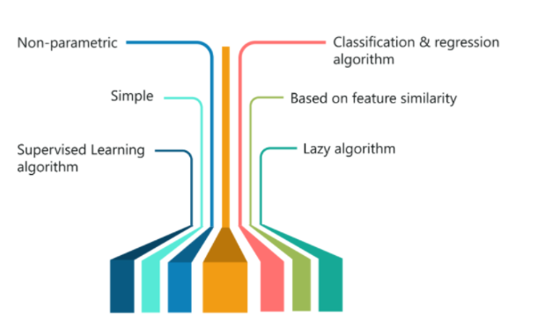
Introduction
KNN or K-Nearest Neighbors classifies a given instance based on the groups of its surrounding “K” number of neighbors.

Slide 5
What are the features of K-NN?
Non-parametric
Classification & regression algorithm
Based on feature similarity
Simple
Lazy learning algorithm
Supervised Learning algorithm

Slide 6

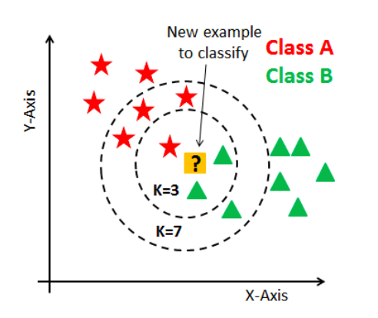
Let’s start with an example
What class will the
yellow point belongs if?
With K=3, which class?
→Green class
With K=7, which class?
→Red class
What if K=14?
If data has an even number of classes, We should choose K as an odd number.

Slide 7
Table of Contents!
1. What is K-NN?
3. What are its Limitation and benefits ?
2. How does it work?
4. Where can we apply K-NN ?

Slide 8
Exam content
Working of K-NN
How to select an appropriate K
Process of K-NN
How to improve K-NN
What happens when K changes
Plotting accuracy rate
Training phase
Testing phase,…
Handling missing value
PCA,…
Overfitting
Underfitting,…

Slide 9

Process of K-NN
In the training phase
In the testing phase
Metric measurements
Only store data points
Calculate the distance to classify each point in the test dataset
Various distances can be calculated based on several measurements

Slide 10
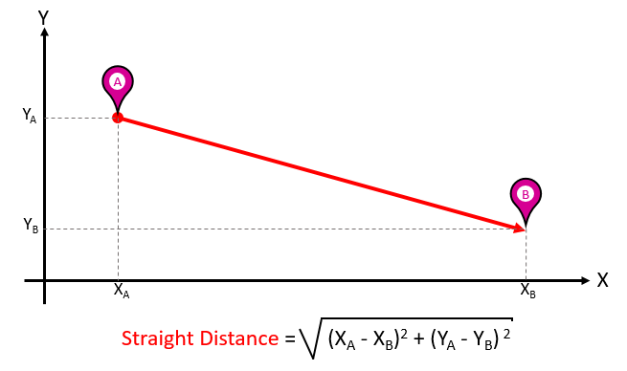
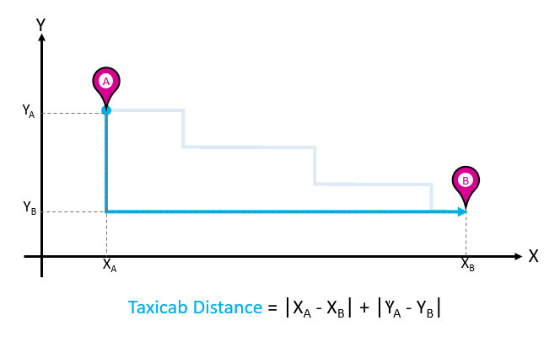
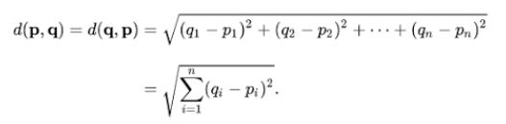

Euclidean Distance
Manhattan Distance

Slide 11


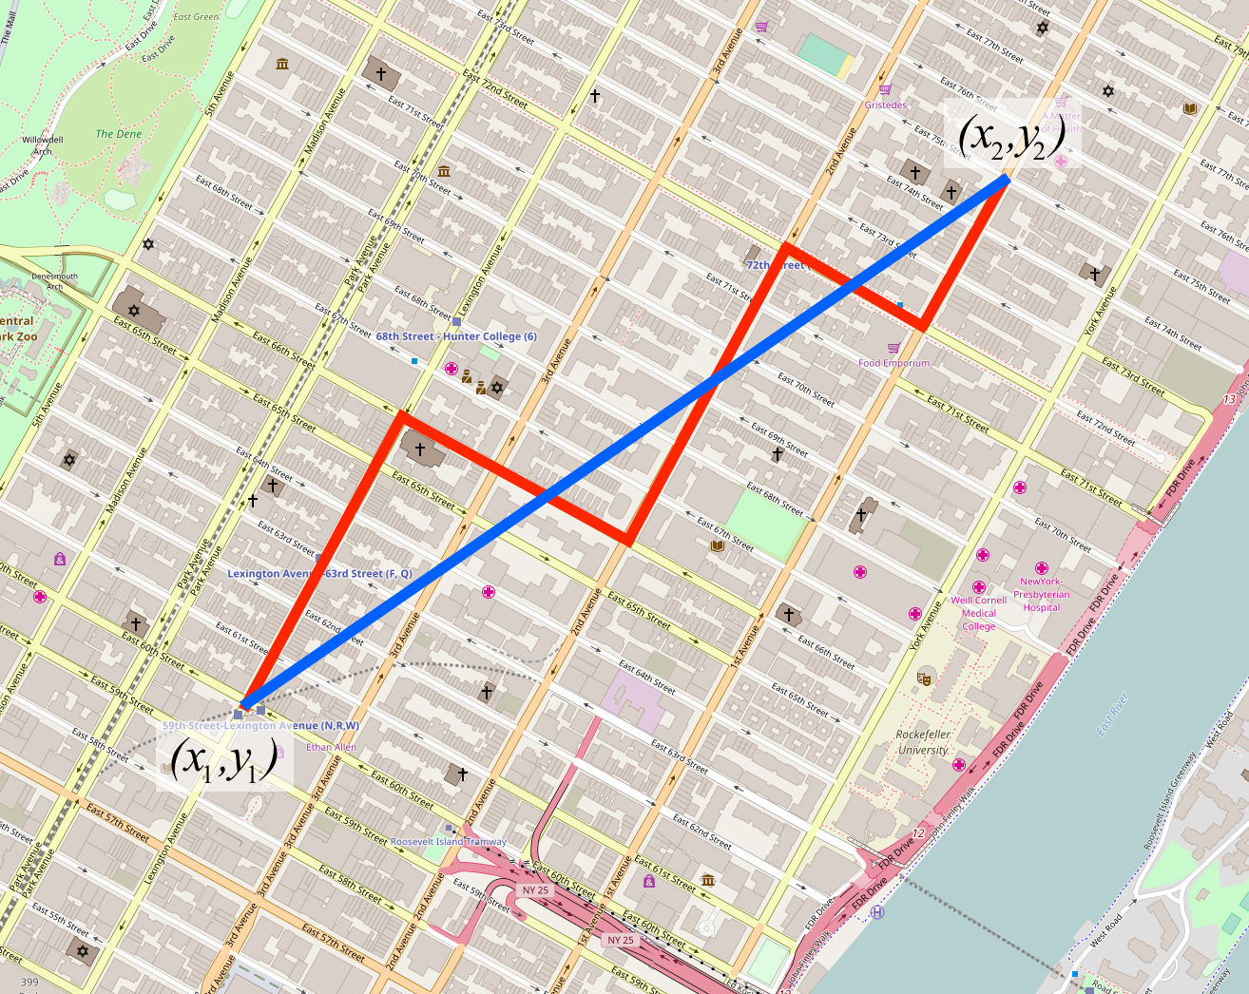
Comparison

Slide 12


All stages of K-NN
Step 1
Step 2
Step 3
Step 4
Find the distance of the new point to each of the training data.
New data point will belong to class that has majority vote.
Classification
Choose an optimal value for K
Count the K nearest neighbors to the new data point.
New data point will be the average of the k neighbors.
Regression

Slide 13

What happens when K changes?
What if there are many outliers ?
The decision surface will consider that as a data point.
Will perform exceptionally well on the training dataset
Will misclassify many points on the test dataset (unseen data).
This is considered as overfitting
⇨KNN is sensitive to outliers.

Slide 14
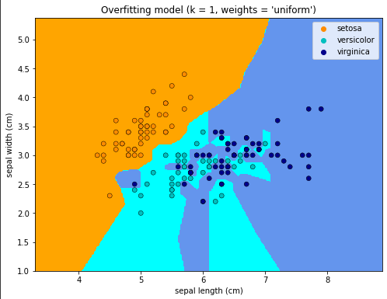
Overfitting

Slide 15
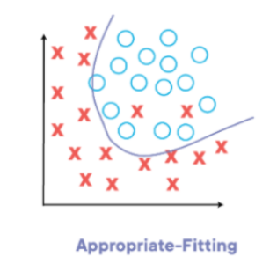
Do You Know This?
Bigger the K is, smoother the surface becomes
But if K value is extremely large, what will happen ?
The model will underfit and be unable to classify the new data point.

Slide 16
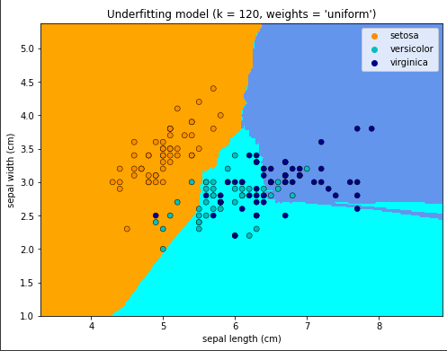
Underfitting

Slide 17
Exam content
What happens when K changes?
How to select an appropriate K
Process of K-NN
How to improve K-NN
What happens when K changes
Plotting accuracy rate
Training phase
Testing phase,…
Handling missing value
PCA,…
Overfitting
Underfitting,…

Slide 18
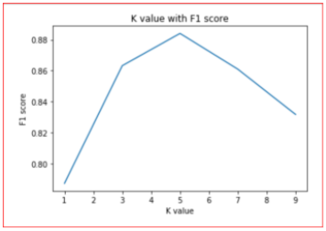
The choice of K influences greatly on predicted results
We have to choose the best K by
accuracy rate of F1 score against
different values of K.
‒> Value of K at the elbow of test error rate gives us the optimal value of K.

Slide 19

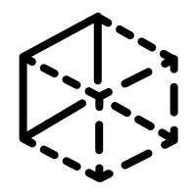

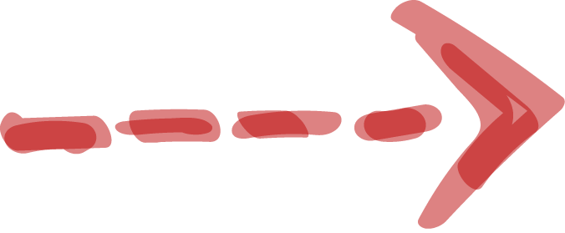
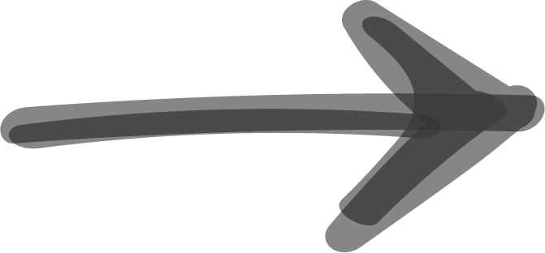
How to improve K-NN
Handling missing values
Normalizing data
Reducing dimensions
PCA

Slide 20
Table of Contents!
1. What is K-NN?
3. What are its limitation and benefits ?
2. How does it work?
4. Where can we apply K-NN ?

Slide 21
Pros
Cons
Simple and easy
Time complexity
The training phase is faster than other algorithms.
Space complexity
Relatively high accuracy compared to other algorithms.
‘The curse of dimensionality’

Slide 22
Table of Contents!
1. What is K-NN?
3. What are its Limitation and benefits ?
2. How does it work?
4. Where can we apply K-NN ?

Slide 23
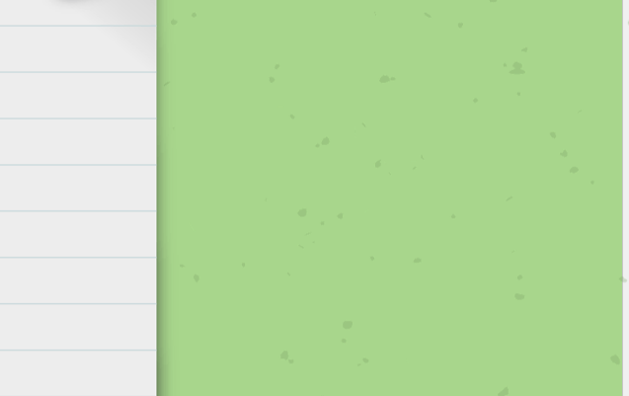
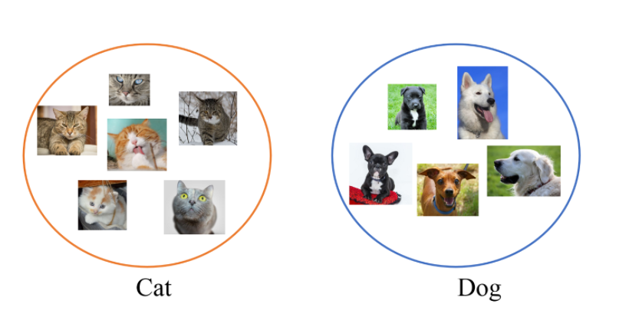

Image classification

Slide 24
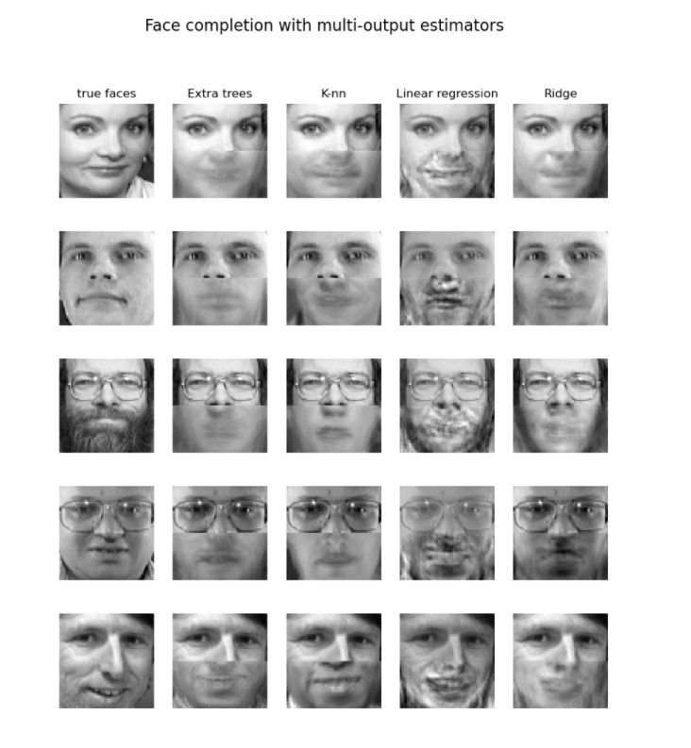

Facial recognition

Slide 25

Recommendation systems
Retail
Agriculture
Finance
Medical
Amazon, Hulu, Netflix, etc.

Slide 26
Code
How I put the theories into my code

Slide 27
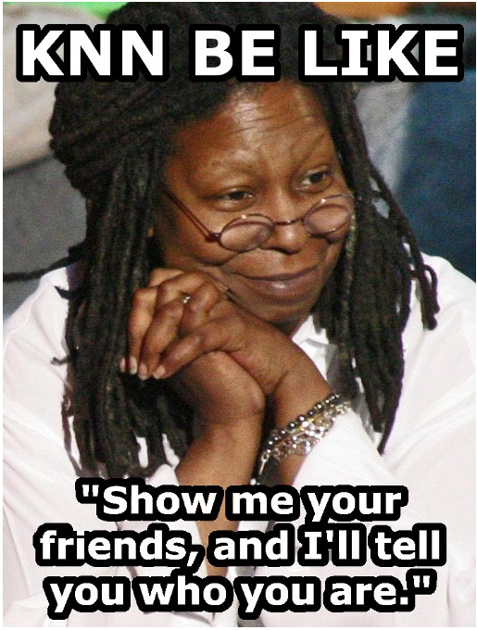
Conclusion
Evaluation
Sensitive with outliers.
Become significantly slower when it comes to the volume of data
⇨ Predictions aren’t able to be made rapidly
Provided you have sufficient computing resources to speedily handle the data, KNN can be useful in solving problems that depends on identifying similar objects.

